Slide 1
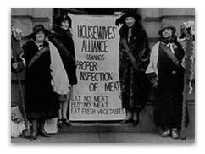
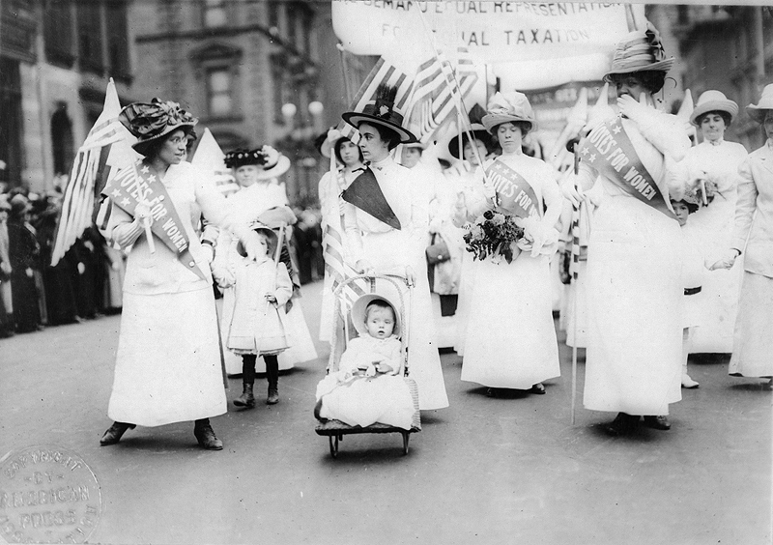
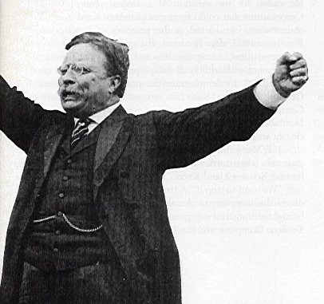
The Progressive Era 1900-1920
An era marked by political, social, and economic reform.
Notes:
The Progressive Era in the United States was a period of reform that flourished from the 1890s to the 1920s. Purification of the system to remove corruption was a main goal of the progressive era, with Progressives trying to expose and undercut political machines and bosses. Many (but not all) Progressives supported prohibition in order to destroy the political power based in saloons. At the same time, women's suffrage was promoted to bring a "purer" female vote into the arena.
Many people led efforts to reform education, medicine, business, church policies, etc. The political leaders included Theodore Roosevelt, Robert M. La Follette, Sr., Charles Evans Hughes and Herbert Hoover on the Republican side, and William Jennings Bryan, Woodrow Wilson and Al Smith on the Democratic side.
Initially the movement was successful at local levels; later it expanded to state and national levels. Progressives drew support from the middle class, and supporters included many lawyers, teachers, physicians, ministers and business people. The Progressives strongly supported scientific methods as applied to government, industry, finance, medicine, schooling, theology, education, and even the family. They closely followed advances underway at the time in Western Europe, and adopted numerous policies, such as the banking laws which became the Federal Reserve System in 1914. They felt that old-fashioned ways meant waste and inefficiency, and eagerly sought out the "one best system".

Slide 2
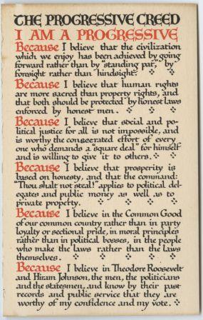

Slide 3
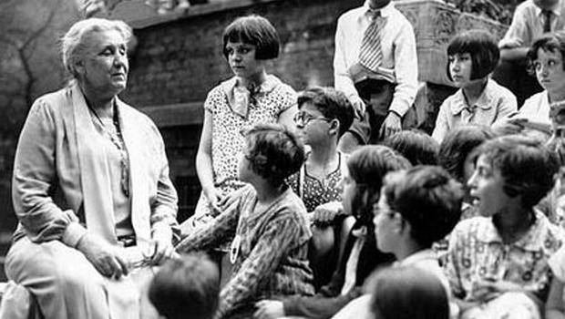
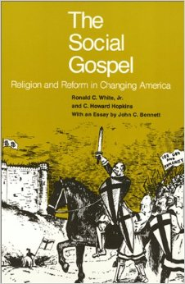
1. Early Reformers – the Roots of Progressive Change
There were no welfare programs during the 1800s. The government did not help the poor. Some individuals took it upon themselves to help make societal changes:
Using private donations and her own funds, Jane Addams established Hull House, the first “settlement house” in Chicago to provide services to the slum residents.
The Social Gospel movement, led by Protestant clergymen, called on Christians to rise to the challenge of helping their fellow man.
Notes:
Throughout the 1800s there were organized efforts to reform specific problems in society
The abolitionist movement worked to end slavery
Temperance activists sought to ban alcohol
The suffrage movement championed women’s right to vote
Individuals worked to improve conditions in our prisons and mental health facilities
Volunteers established “settlement houses” in cities to provide services to poor immigrants
Gospel – something you believe in strongly, and think others should believe in as well.
The Progressive Era started in 1800s, culminated 1900-1920.

Slide 4

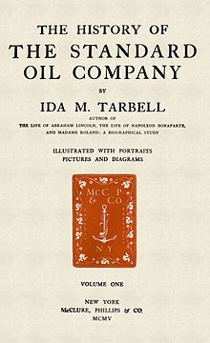
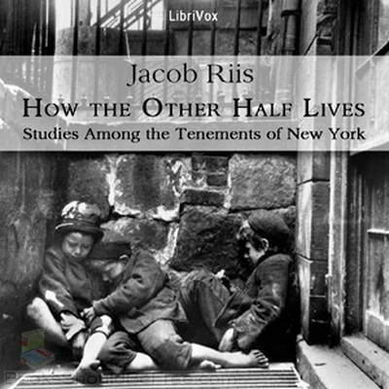
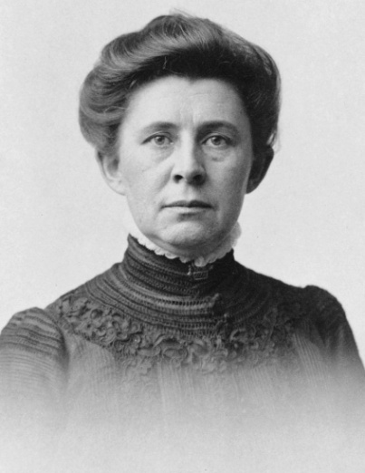
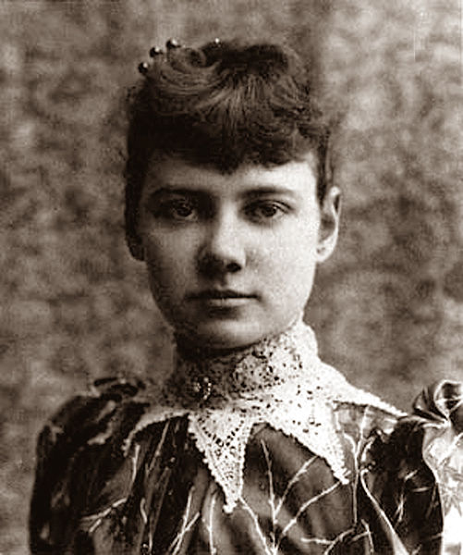
“Muckraker” journalists called attention to corruption in government, poor working conditions, and poverty in cities. Examples:
Jacob Riis
Ida Tarbell – her investigative reporting led to the breakup of the Standard Oil Company's monopoly
Nellie Bly
Notes:
During the Gilded Age in the late 1800s, muckraking journalists called attention to corruption in government, poor working conditions, and poverty in cities.
While he may never have used the term himself, the origin of the term "muckraker" is attributed to President Theodore Roosevelt, who, during a speech delivered on April 14, 1906, drew on a character from John Bunyan’s 1678 classic, Pilgrim’s Progress, saying:
“... you may recall the description of the Man with the Muck-rake, the man who could look no way but downward with the muck-rake in his hands; Who was offered a celestial crown for his muck-rake, but who would neither look up nor regard the crown he was offered, but continued to rake to himself the filth of the floor.”
While cautioning about possible pitfalls of keeping one's attention ever trained downward, "on the muck," Roosevelt emphasized the social benefit of investigative muckraking reporting, saying:
There are, in the body politic, economic and social, many and grave evils, and there is urgent necessity for the sternest war upon them. There should be relentless exposure of and attack upon every evil man whether politician or business man, every evil practice, whether in politics, in business, or in social life. I hail as a benefactor every writer or speaker, every man who, on the platform, or in book, magazine, or newspaper, with merciless severity makes such attack, provided always that he in his turn remembers that the attack is of use only if it is absolutely truthful.
—Theodore Roosevelt
The term eventually came to be used in reference to investigative journalists who reported about and exposed issues such as crime, fraud, waste, public health and safety, graft, illegal financial practices — when found within America and, by association, foreign interests, for example, as partners and co-conspirators. A muckraker's reporting may span businesses and government generally, especially where such have elements of both involved in the same report.
Nellie Bly, considered to be the first muckraker; she faked insanity to study a mental institution from within .

Slide 5
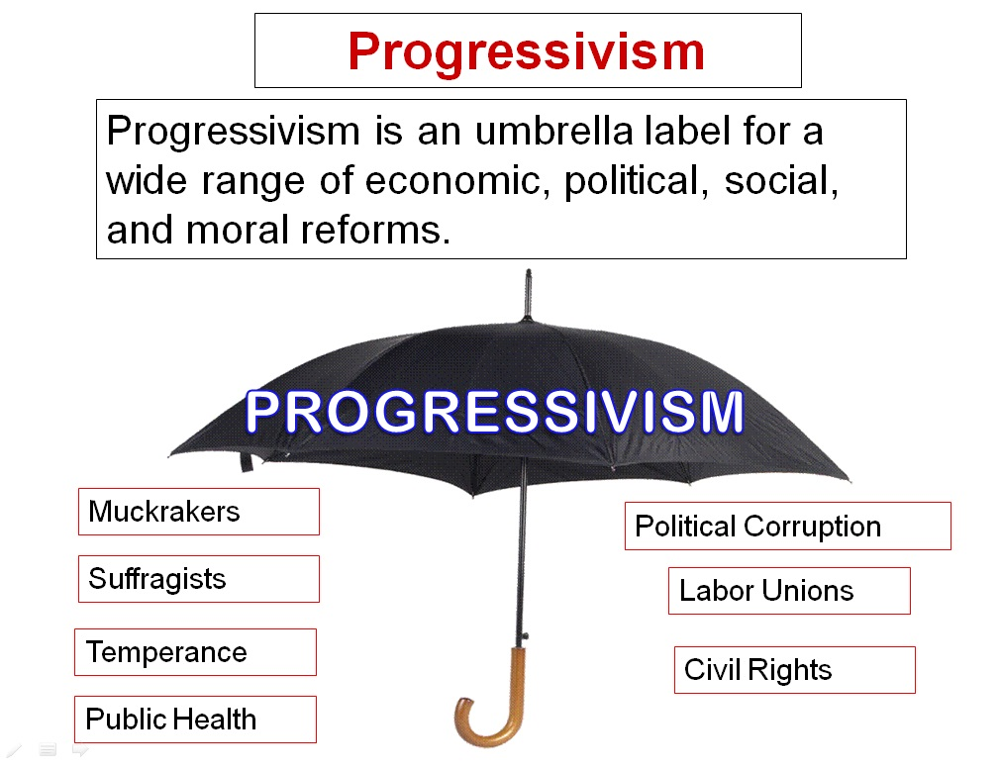
By 1900, the growing middle class had come to believe that the government could play an active role in improving our society.
Under the “umbrella” of the “Progressive Movement”, they pursued a variety of reforms.
Notes:
“Umbrella” insurance policies cover a wide range of situations.

Slide 6
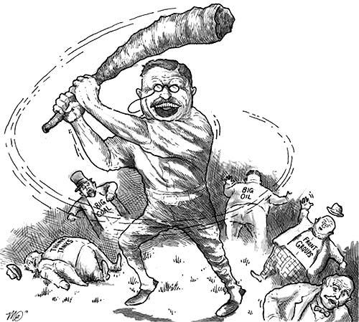
3. Breaking Up the Trusts
Theodore Roosevelt, the first president of the Progressive Era, liked to be known as a “trust-buster.”
Two pieces of legislation were enacted with the aim of ending trusts:
The Sherman Anti-Trust Act of 1890
The Clayton Anti-Trust Act of 1914
Trust Buster clip (yikes it's silly :o))
Notes:
The Sherman Antitrust Act requires the United States Federal government to investigate and pursue trusts, companies and organizations suspected of violating the Act. It was the first Federal statute to limit cartels and monopolies, and today still forms the basis for most antitrust litigation by the United States federal government.
The Clayton Antitrust Act, passed in 1914, proscribes certain additional activities that had been discovered to fall outside the scope of the Sherman Antitrust Act. For example, the Clayton Act added certain practices to the list of impermissible activities:
price discrimination between different purchasers, if such discrimination tends to create a monopoly
exclusive dealing agreements
tying arrangements
mergers and acquisitions that substantially reduce market competition.

Slide 7
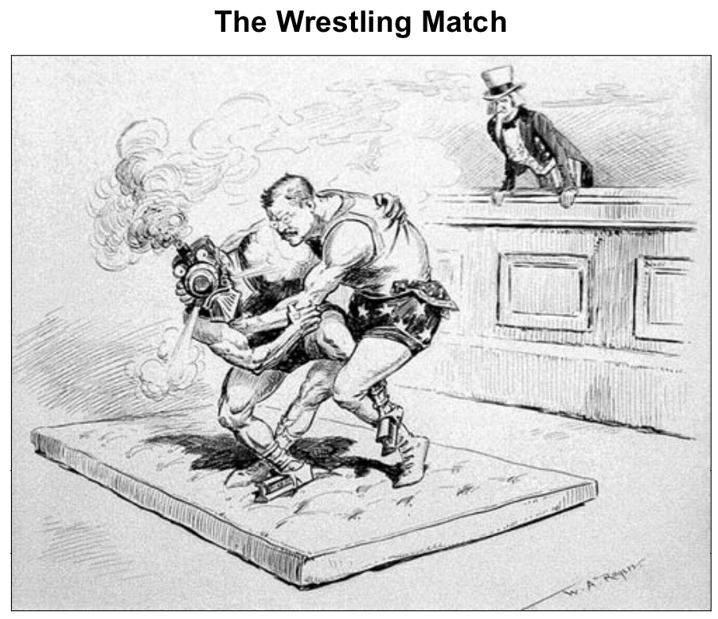
Notes:
Wrestling the Railroad trusts.

Slide 8
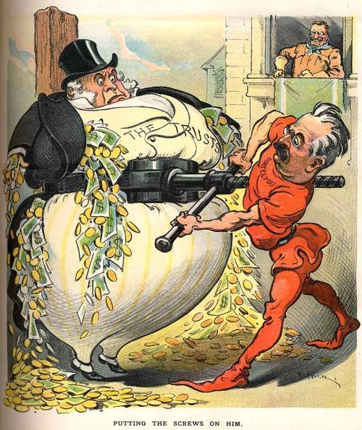

Slide 9
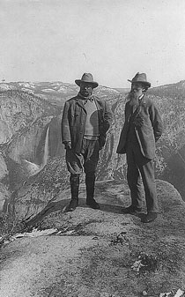
4. Preserving Nature
The conservation movement began during the Progressive Era
1903 - First national wildlife refuge (in Florida)
1905 - U.S. Forest Service created
Altogether, Roosevelt set aside 16 national monuments, 51 wildlife refuges and 5 new national parks (including the Grand Canyon, Mesa Verde, and Yosemite National Park)
Notes:
John Muir (21 April 1838 – 24 December 1914) was a Scottish-born American naturalist, author, and early advocate of preservation of wilderness in the United States. His letters, essays, and books telling of his adventures in nature, especially in the Sierra Nevada mountains of California, have been read by millions. His activism helped to save the Yosemite Valley, Sequoia National Park and other wilderness areas. The Sierra Club, which he founded, is now one of the most important conservation organizations in the United States.
Conservation – protecting plants, animals and their habitats.

Slide 10
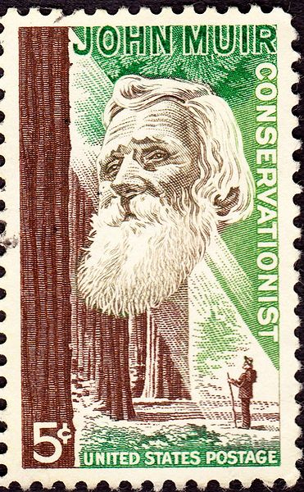
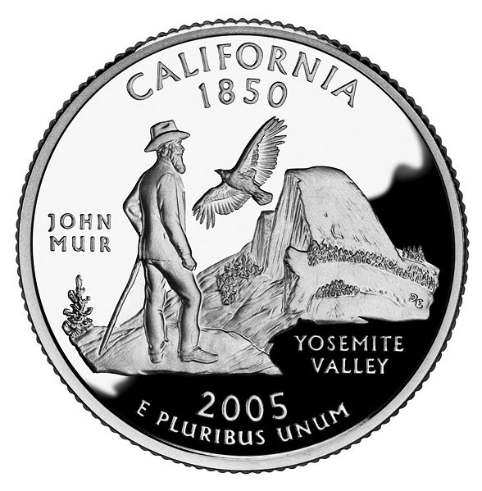
Notes:
An image of Muir, with the California Condor and Half Dome, appears on the California state quarter which was released in 2005.

Slide 11
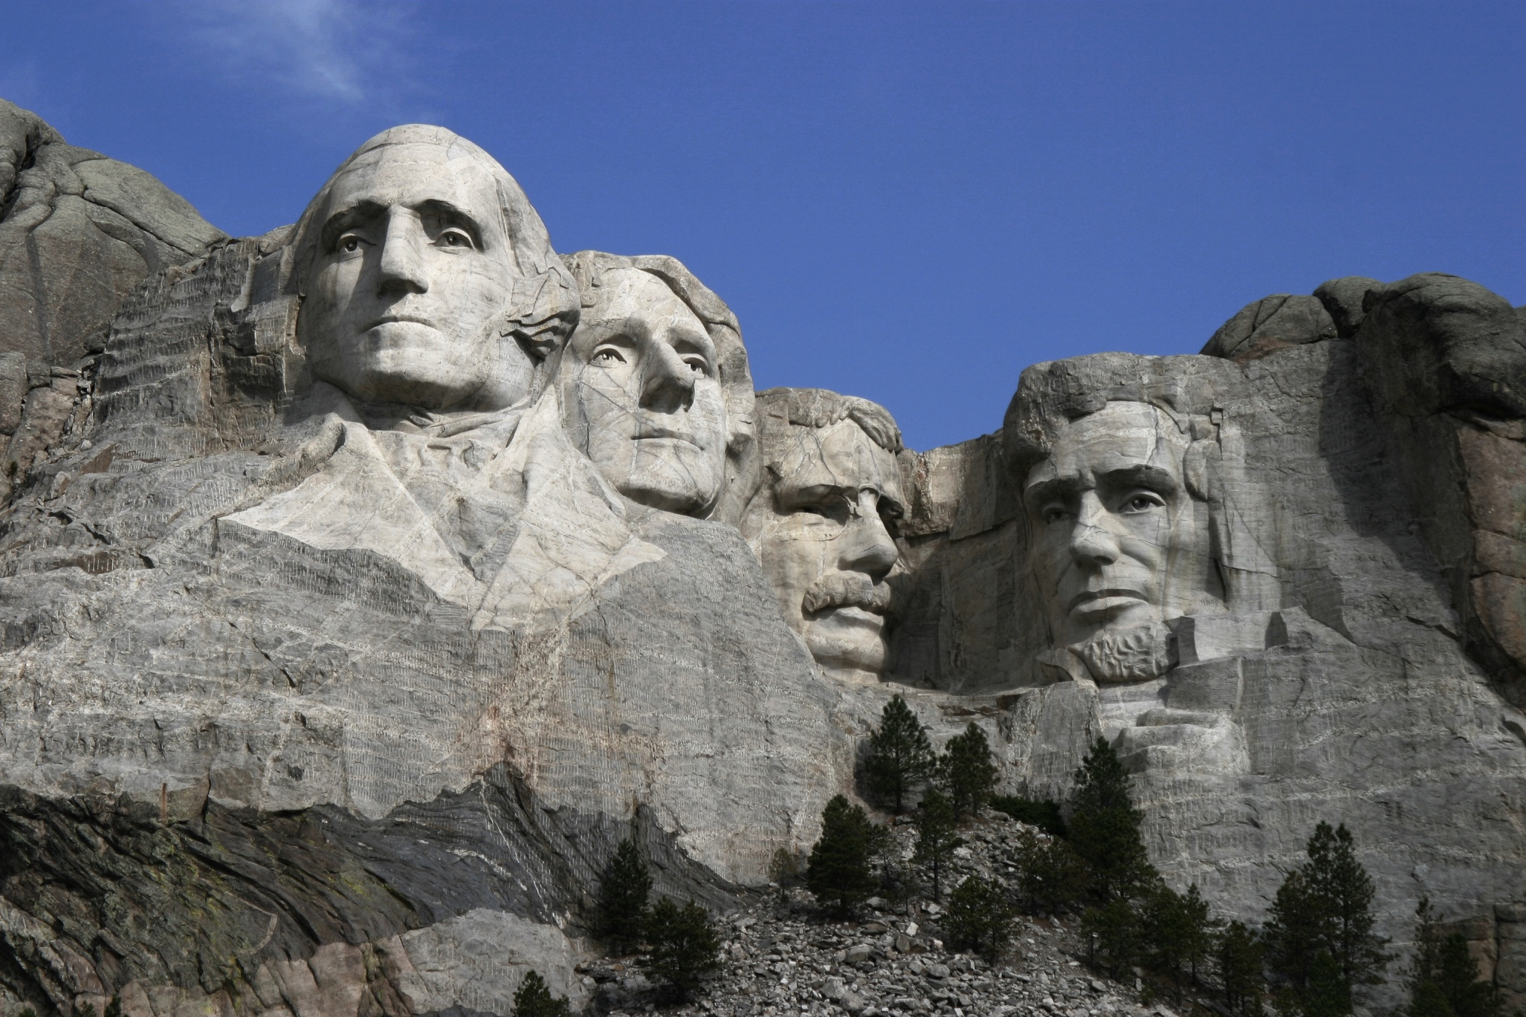
Mount Rushmore clip
Notes:
Mount Rushmore National Memorial is a sculpture carved into the granite face of Mount Rushmore near Keystone, South Dakota, in the United States. Sculpted by Gutzon Borglum and later by his son Lincoln Borglum, Mount Rushmore features 60-foot sculptures of the heads of former United States presidents (in order from left to right) George Washington, Thomas Jefferson, Theodore Roosevelt and Abraham Lincoln. The entire memorial is 5,725 feet above sea level.
South Dakota historian Doane Robinson is credited with conceiving the idea of carving the likenesses of famous people into the Black Hills region of South Dakota in order to promote tourism in the region. Robinson's initial idea was to sculpt the Needles; however, Gutzon Borglum rejected the Needles site and chose the larger Mount Rushmore. Borglum also decided the sculpture should have a more national focus, and chose the four presidents whose likenesses would be carved into the mountain. After securing federal funding, construction on the memorial began in 1927, and the presidents' faces were completed between 1934 and 1939. Upon Gutzon Borglum's death in March 1941, his son Lincoln Borglum took over construction. Though the initial concept called for each president to be depicted from head to waist, lack of funding forced construction to end in October 1941.
The U.S. National Park Service took control of the memorial in 1933, while it was still under construction, and manages the memorial to the present day. It attracts approximately two million people annually
Untold Stories – Mount Rushmore – approx 10 mins

Slide 12
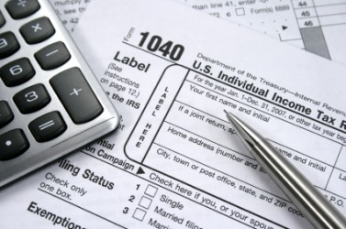
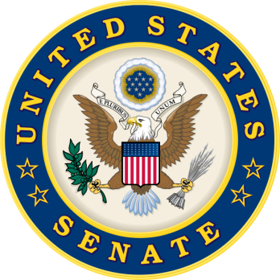
5. Expanding Democracy: Results of Populist Party Efforts!
The SiXteenth Amendment made it legal for the national government to collect income taXes.
The SEventeenth Amendment changed the way our U.S. SEnators are chosen (They are now directly elected by the citizens of their states, not by their state legislatures, as they had been before)
(See bold/capitalized memory hints above.)
Notes:
The 16th Amendment is the constitutional law that empowers the federal government to levy income taxes on its citizens. Although income taxes were implemented at various times in history, those laws were short-term and generally involved a national emergency. With the adoption of the 16th Amendment, the government was given increased political power to establish the present form of taxation.
History -- In 1861, the Revenue Act was passed by Congress in an effort to collect income tax to fund the Civil War. Three percent of a person's income was taken on all revenue over $800. This was changed to a tax rate of 3 percent to 5 percent the following year, depending on income level. However, this tax expired in 1866. Over the next few decades, debate continued over establishing a permanent income tax with very little action from the government.
Time Frame -- The law that became the 16th Amendment was introduced by President William Howard Taft on June 16, 1909.
Effects -- Due to the fact that the 16th Amendment was passed through all of the necessary steps to become a constitutional law, the government was allowed to levy income taxes on its citizens and wage earners. Since its adoption, the Bureau of Internal Revenue was changed into the Internal Revenue Service and given new authority to enforce taxation law. In addition, the extra income for the country gave the federal government increased abilities to adopt new powers and programs

Slide 13
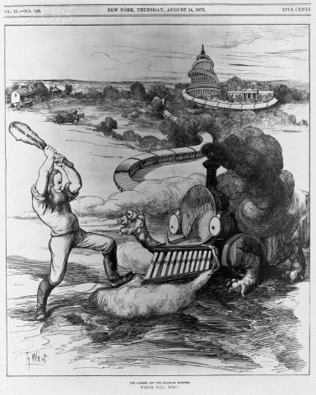
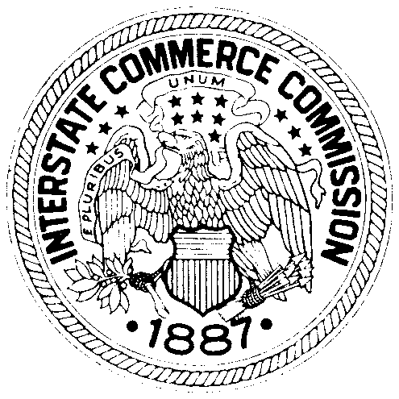
The Interstate Commerce Act – prohibited railroads from overcharging for transportation
The Interstate Commerce Commission – created to investigate complaints and to enforce the Act – the first federal government agency to regulate unfair business practices.
Notes:
This was a move away from the laissez-faire policies of the past.

Slide 14
Initiative – a way for citizens to initiate laws
Provides that the state legislature must consider passing a law if a certain percentage of voters sign a petition in its favor
A form of DIRECT DEMOCRACY.

Slide 15

Referendum – referring existing laws to the people for a vote
Requires that a law or constitutional amendment passed by a state legislature be submitted to voters for their approval.
A form of DIRECT DEMOCRACY.
Notes:
Originated by petition.
Example: Red light cameras – on the Houston ballot a couple of years ago – voters got them removed through referendum.

Slide 16
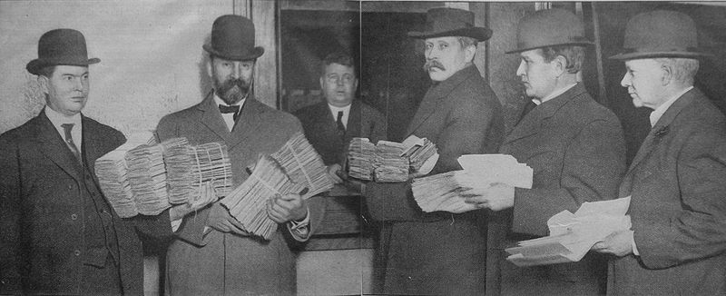
Recall
Permits voters to petition for, and vote upon, the removal (recall) of elected officials before their term expires.
Notes:
Submitting petitions for the recall of Seattle, Washington mayor Hiram Gill in December 1910; Gill was removed by a recall election the following February, but voters returned him to the office in 1914. He had corrupt practices, loose laws, tolerated prostitution, alcohol & gambling. Changed his policies and ran again later.
Citizens can recall an elected official. State and local level.

Slide 17
The Issue of Child Labor
Background: Up until the early 1900s, child labor laws varied from state-to-state.
Some states continued to allow children as young as 5 or 6 years old to work long days in the factories. Many poor families chose to send their kids to work instead of school.
Notes:
Background – not in your notes

Slide 18
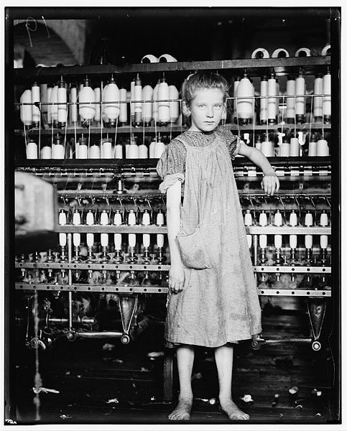
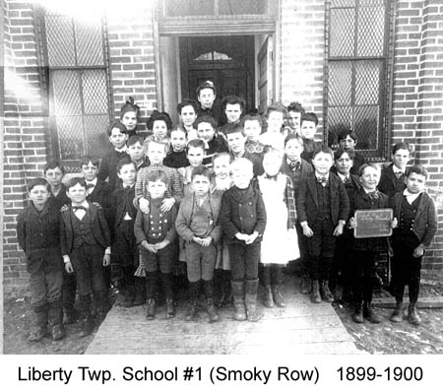
At this time, the U.S. Constitution was interpreted to mean that only state governments, not the national government, could pass laws related to child labor.
Many progressive state governments set minimum age laws or mandatory school attendance laws during the Progressive Era.
Notes:
By 1900, 34 states had compulsory schooling laws (only 4 states in the South)
Most of these laws required children to attend school until 14 yrs old.
By 1910, 72% of American children attended school.
By 1918, every state required students to complete elementay school.
Horace Mann – fought to promote public schools.
Public schools promoted a common education – helped immigrants “Americanize”

Slide 19
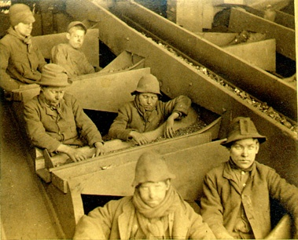
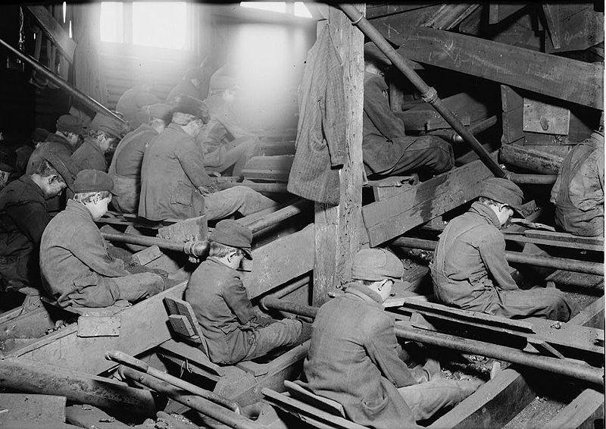
“Breaker Boys”
Notes:
Read Breaker Boys excerpt in notes.

Slide 20
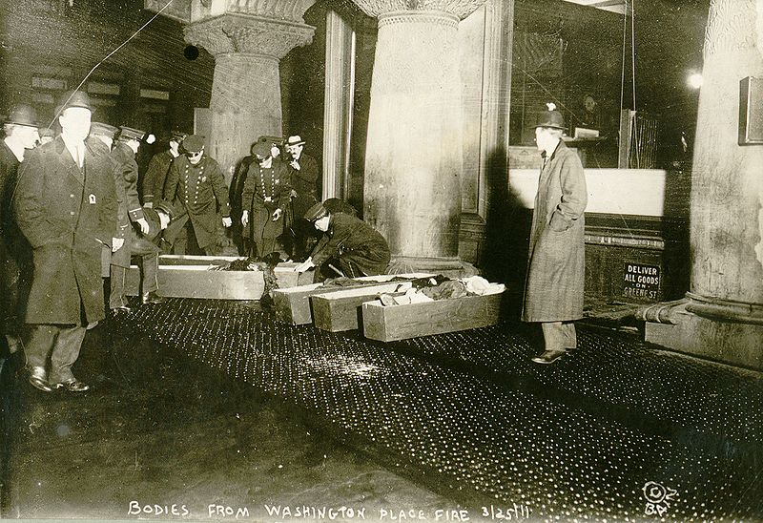
7. Health & Safety Issues
A devastating fire at the Triangle Shirtwaist Co. in New York City caused the passage of strict building codes dealing with fire hazards and unsafe machinery and working conditions.
Notes:
Show America the Story of US clip

Slide 21
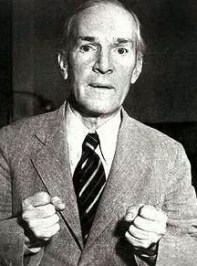
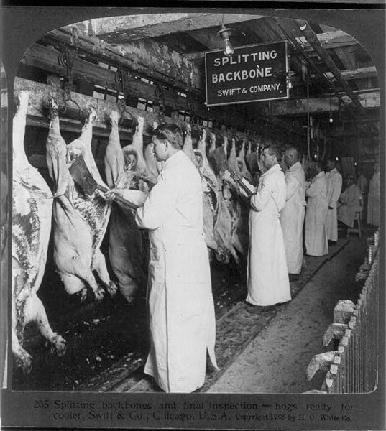
In 1906, Upton Sinclair published The Jungle, a novel based on his observations of slaughterhouses in Chicago (read excerpt in notes)
The Jungle clip
His work led to passage of the:
Meat Inspection Act, and
Pure Food and Drug Act.
Notes:
The Jungle is a 1906 novel written by author and journalist Upton Sinclair. Sinclair wrote the novel to highlight the plight of the working class and to show the corruption of the American meatpacking industry during the early-20th century. The novel depicts in harsh tones poverty, absence of social programs, unpleasant living and working conditions, and hopelessness prevalent among the working class, which is contrasted with the deeply-rooted corruption on the part of those in power. Sinclair's observations of the state of turn-of-the-century labor were placed front and center for the American public to see, suggesting that something needed to be changed to get rid of American "wage slavery".
The 1906 Act paved the way for the eventual creation of the Food and Drug Administration (FDA) and is generally considered to be that agency's founding date, though the agency existed before the law was passed and was not named FDA until later. The law itself was largely replaced by the much more comprehensive Food, Drug, and Cosmetic Act of 1938
The Pure Food and Drug Act required that certain specified drugs, including alcohol, cocaine, heroin, morphine, and cannabis, be accurately labeled with contents and dosage. Previously many drugs had been sold as patent medicines with secret ingredients or misleading labels. Cocaine, heroin, cannabis, and other such drugs continued to be legally available without prescription as long as they were labeled.
Video 6:00

Slide 22
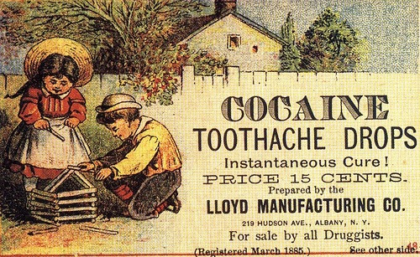
Notes:
The Pure Food and Drug Act required that certain specified drugs, including alcohol, cocaine, heroin, morphine, and cannabis, be accurately labeled with contents and dosage. Previously many drugs had been sold as patent medicines with secret ingredients or misleading labels. Cocaine, heroin, cannabis, and other such drugs continued to be legally available without prescription as long as they were labeled.

Slide 23
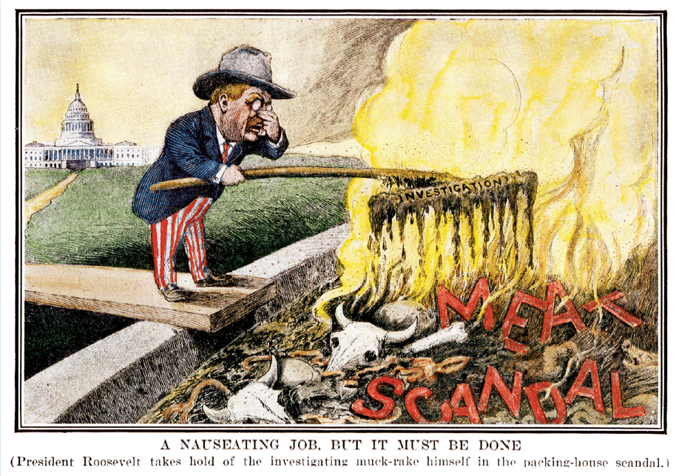
Notes:
The Federal Meat Inspection Act of 1906 works to prevent adulterated or misbranded meat and meat products from being sold as food and to ensure that meat and meat products are slaughtered and processed under sanitary conditions

Slide 24
Answer the following questions on your own paper (be sure to write your name and today’s date at the top):
1. Define the following terms:
Initiative
Referendum
Recall
16th Amendment
17th Amendment
2. What was the term we learned that was used to describe “investigative reporters” during the Progressive Era?

Slide 25
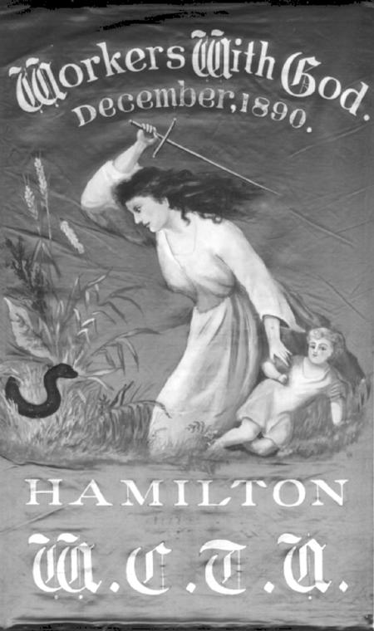
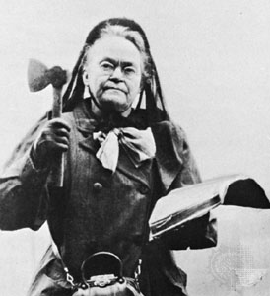
8. The Temperance Movement Temperance: Abstinence from or moderation in drinking alcoholic beverages
Throughout the late 1800s and early 1900s, social reformers and women’s groups worked to ban the sale of alcohol.
They believed that most social problems were caused or compounded by alcohol use.
Notes:
tem·per·ance - noun 1. moderation or self-restraint in action, statement, etc.; self-control.
2. habitual moderation in the indulgence of a natural appetite or passion, especially in the use of alcoholic liquors.
3. total abstinence from alcoholic liquors.
A temperance movement is a social movement against the use of alcoholic beverages. Temperance movements may criticize excessive alcohol use, promote complete abstinence, or pressure the government to enact anti-alcohol legislation.
Women’s Christian Temperance Union; Carrie Nation
Because of the correlation between drinking and domestic violence—many drunken husbands abused family members—the temperance movement existed alongside various women's rights and other movements, including the Progressive movement, and often the same activists were involved in all of the above. Many notable voices of the time, ranging from Lucy Webb Hayes to Susan B. Anthony, were active in the movement.
The Eighteenth Amendment (Amendment XVIII) of the United States Constitution, along with the Volstead Act, which defined "intoxicating liquors" excluding those used for religious purposes and sales throughout the U.S., established Prohibition in the United States. Its ratification was certified on January 16, 1919. It was repealed by the Twenty-first Amendment in 1933, the only instance of an amendment's repeal.
Prohibitionists argued that Prohibition would be more effective if enforcement were increased. However, increased efforts to enforce Prohibition simply resulted in the government spending more money, rather than less. The economic cost of Prohibition became especially pronounced during the Great Depression. According to Association Against the Prohibition Amendment (AAPA) and Women's Organization for National Prohibition Reform (WONPR) literature, an estimated $861,000,000 was lost in federal tax revenue from untaxed liquor; $40 million dollars was spent annually on Prohibition enforcement. The AAPA also released a pamphlet claiming that $11,000,000,000 was lost in federal liquor-tax revenue and $310,000,000 was spent on Prohibition enforcement from 1920 to 1931. This lack of potential funding during a period of economic strife became a crucial part of the campaign for repeal.

Slide 26
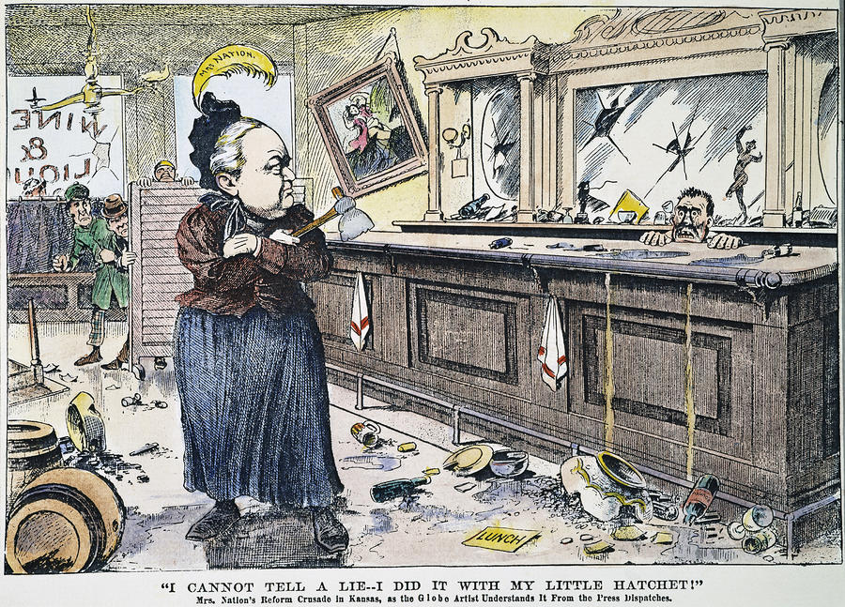

Slide 27
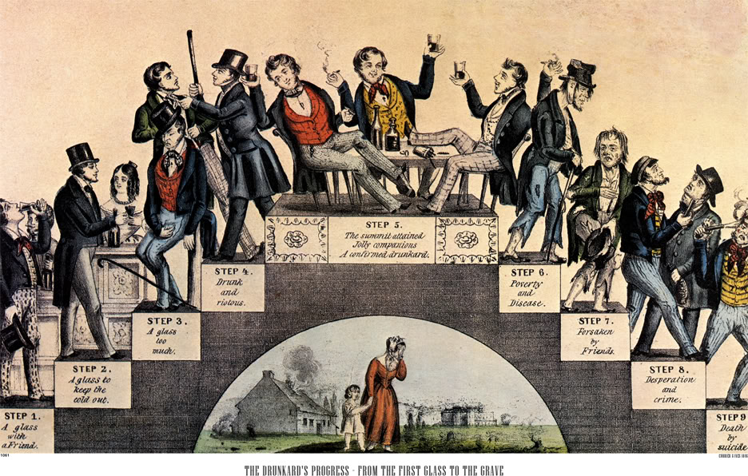
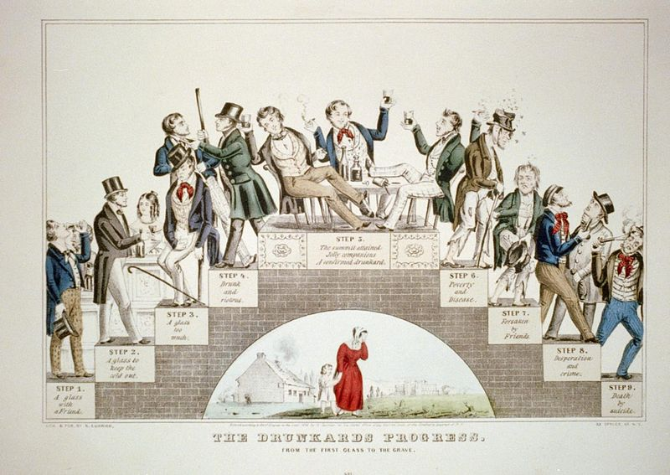
Notes:
The Drunkards Progress. From the first glass to the grave.
Step 1. A glass with a friend.
Step 2. A glass to keep the cold out.
Step 3. A glass too much.
Step 4. Drunk and riotous.
Step 5. The summit attained. Jolly companions. A confirmed drunkard.
Step 6. Poverty and disease.
Step 7. Forsaken by Friends.
Step 8. Desperation and crime.
Step 9. Death by suicide.

Slide 28
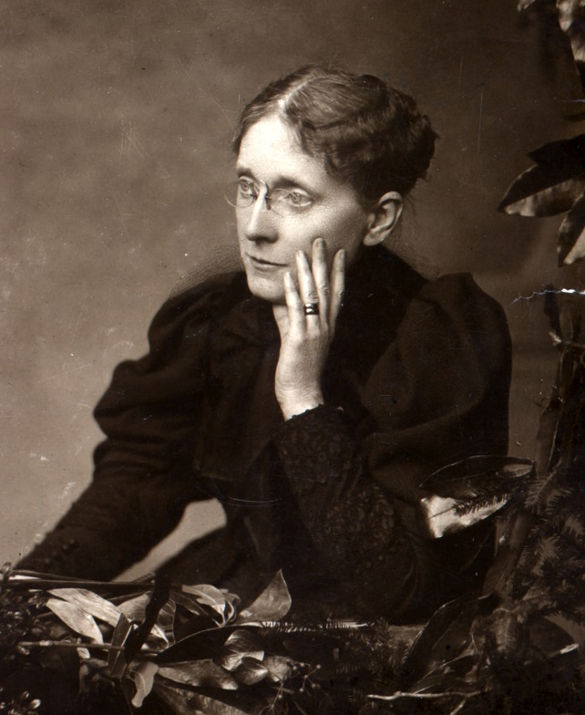
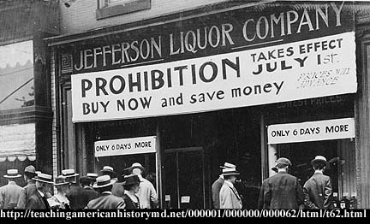
Frances Willard was one of the most outspoken voices of the Temperance Movement. Her own brother had been an alcoholic.
The 18th Amendment was passed in 1919 and the Prohibition Era began. The amendment banned the transport, production, and sale of alcoholic beverages in the US.
Notes:
In 1879, Willard was elected as president of the National Women’s Temperance Union. During her nineteen years as president, Willard advocated women’s rights, suffrage, prison reform for women, an eight-hour workday, and improved working conditions in factories. In 1882, Willard organized the Prohibition Party. By 1919, the work of Willard and other reformers had created efficient pressure to persuade enough states to ratify the 18th Amendment, banning the transport, production, and sale of alcoholic drinks.

Slide 29
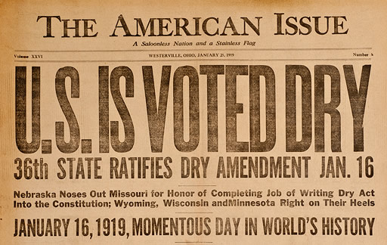

Slide 30
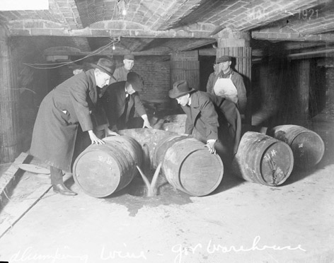
Notes:
Prohibition agents destroying barrels of alcohol.

Slide 31
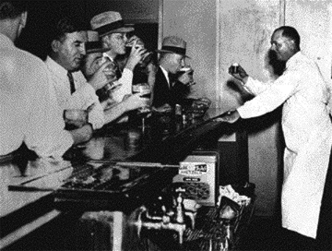
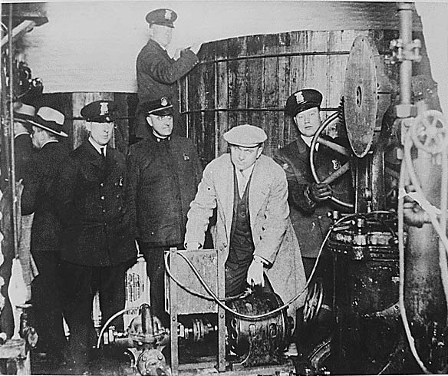
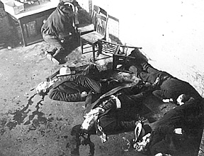
Prohibition led to several undesirable effects:
bootlegging (illegal manufacturing of alcohol)
organized crime and
speakeasies (illegal bars)
Notes:
North Side Gang members following the St. Valentine's Day Massacre, Chicago. Al Capone
Detroit police inspecting equipment found in a clandestine underground brewery during the Prohibition era
Speakeasy – establishment that illegally sells alcoholic beverages. The term "speakeasy" might have originated in Pennsylvania in 1888, when the Brooks High-License Act raised the state's fee for a saloon license from $50 to $500. The number of licensed bars promptly plummeted, but some bars continued to operate illegally. Kate Hester had run a saloon for years in McKeesport, just outside of Pittsburgh. She refused to pay the new license fee and wanted to keep from drawing attention to her illegal business. When her customers got too rowdy, she would hush them by whispering, "Speak easy, boys! Speak easy!" This expression became common in McKeesport and spread to Pittsburgh.
An alternative theory is that the term was simply derived from a patron's manner of ordering alcohol without raising suspicion—bartenders would tell patrons to be quiet and "speak easy".[

Slide 32
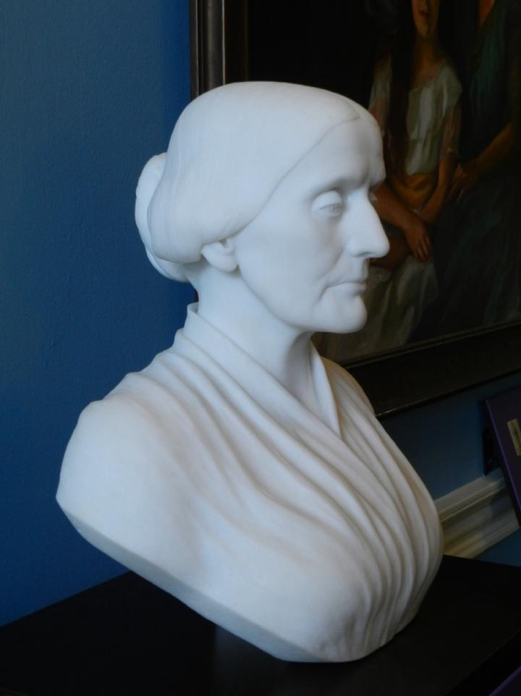
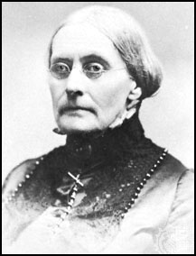
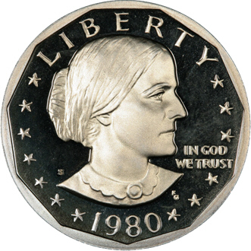
9. Women’s Suffrage
Efforts to earn women the right to vote were kicked off by an 1848 convention in Seneca Falls, NY.
Susan B. Anthony was one of many famous “suffragists” who worked throughout the second half of the 19th Century and the Progressive Era to win women the right to vote.
The 19th Amendment finally gave women the right to vote in national elections in 1920.

Slide 33
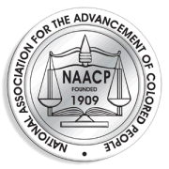
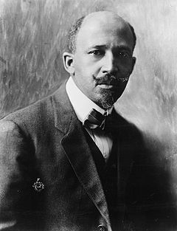
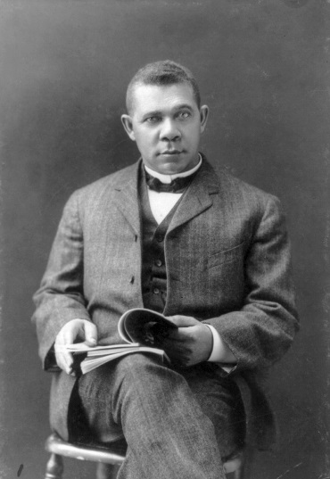
10. Early Civil Rights Efforts
A major accomplishment in minority rights during this period was the establishment of the National Association for the Advancement of Colored People (NAACP) by W.E.B. Du Bois and others. The NAACP fought for the civil rights of African Americans.
Other leaders like Booker T. Washington argued that African Americans should seek gradual equality, focus on job training, and not be too demanding.

Slide 34


Another leading voice in the early fight for civil rights was Ida B. Wells.
When three of Wells’ male friends were lynched (hanged) for crimes they did not commit, Wells organized a national anti-lynching campaign
Notes:
Her research revealed that 728 African American men and women had been lynched in the previous decade.
In 1889 Thomas Moss, a friend of Wells, opened the People's Grocery in the "Curve," a black neighborhood just outside the Memphis city limits. It did well and competed with a white-owned grocery store across the street. While Wells was out of town in Natchez, Mississippi, a white mob invaded her friends' store. During the altercation, three white men were shot and injured. Moss, and two other black men, named McDowell and Stewart, were arrested and jailed pending trial. A large white lynch mob stormed the jail and killed the three men.
After the lynching of her friends, Wells wrote in Free Speech and Headlight, urging blacks to leave Memphis:
There is, therefore, only one thing left to do; save our money and leave a town which will neither protect our lives and property, nor give us a fair trial in the courts, but takes us out and murders us in cold blood when accused by white persons.
Wells emphasized the public spectacle of the lynching. More than 6,000 blacks did leave Memphis; others organized boycotts of white-owned businesses. After being threatened with violence, she bought a pistol. She later wrote, "They had made me an exile and threatened my life for hinting at the truth.
The murder of her friends drove Wells to research and document lynchings and their causes. She began investigative journalism by looking at the charges given for the murders. She also officially started her anti-lynching campaign. She spoke on the issue at various black women’s clubs, and raised more than $500 to investigate lynchings and publish her results. Wells found that blacks were lynched for such reasons as failing to pay debts, not appearing to give way to whites, competing with whites economically, and being drunk in public. She found little basis for the frequent claim that blacks were lynched because they had abused or assaulted white women. She published her findings in a pamphlet entitled "Southern Horrors: Lynch Law in All Its Phases.“ She wrote an article that suggested that, unlike the myth that white women were sexually at risk of attacks by black men, most liaisons between black men and white women were consensual. On May 27, 1892, while she was away in Philadelphia, a mob destroyed the offices of the Free Speech and Headlight in retaliation for her controversial articles.

Slide 35



11. Woodrow Wilson’s “New Freedom”
Woodrow Wilson took office in 1913, with the goals of taming big business, encouraging greater competition, and eliminating special privileges.
His most important reforms included:
The Federal Reserve Act (1913) – reformed the banking industry by establishing 12 regional Federal Reserve Banks, and a Federal Reserve Board that regulates the availability of credit and controls the nation’s money supply
The Federal Trade Commission Act (1914) – created the Federal Trade Commission (FTC) to investigate unfair business practices. This helps protect consumers.
Notes:
While Roosevelt was emotional and enthusiastic, Wilson was cool and logical. In the election campaign, Wilson promised Americans a “New Freedom” – taming big business, encouraging greater competition, and eliminating special privileges. Once elected, Wilson quickly pushed several major reforms through Congress.

Slide 36


Federal Reserve Districts

Slide 37


- The Department of Labor (1913) – a special Cabinet post to study the problems of labor, collect statistics, and enforce federal labor laws.
- The National Park Service (1916) – created to conserve the natural scenery, historic objects, and wildlife for the enjoyment of the American people.

Slide 38

Notes:
National Parks map

Slide 39

12. The Progressive Era and WWI
Americans went off to war in 1917 with a progressive zeal, believing that they would “make the world safe for democracy” and that this might be the last war of all time.
Despite the Allied victory in 1918, the brutality of the war and the harsh terms of the Treaty of Versailles damaged the progressive spirit in America and turned public attention away from reform.

Slide 40
Imperialism- the policy in which stronger nations extend their economic, political, or military control over weaker territories.

Slide 41





Imperialists
1. Pres. Teddy Roosevelt
2. Senator Henry Cabot Lodge
3. Alfred T. Mahan (US Navy)
4. Rudyard Kipling – author
5. Josiah Strong – missionary
Notes:
Sentator Beveridge – “In Support of an American Empire” speech to Congress: We will not renounce our part in the mission of our race, trustee, under God, of the civilization of the world. And we will move forward to our work, not howling out regrets like slaves whipped to their burdens but with gratitude for a task worthy of our strength and thanksgiving to Almighty God that He has marked us as His chosen people, henceforth to lead in the regeneration of the world.
Mahan - His concept of "sea power" was based on the idea that the most powerful navy will control the globe; it was most famously presented in The Influence of Sea Power Upon History, 1660-1783 (1890). The concept had an enormous influence in shaping the strategic thought of navies across the world, especially in the United States, Germany, Japan and Britain. His ideas still permeate the U.S. Navy. Has had several ships named after him. Building a modern navy means the US will have to acquire territory for naval bases.
Kipling – White Man’s Burden
Josiah Strong – Minister and Missionary. Strong argued that the "Anglo-Saxon race" had a responsibility to "civilize and Christianize" the world, sharing their technology and knowledge of Christianity.

Slide 42



Anti-Imperialists
1. American Anti-Imperialist League
2. Andrew Carnegie
3. Mark Twain
Notes:
The American Anti-Imperialist League was an organization established in the United States on June 15, 1898 to battle the American annexation of the Philippines as an insular area. The anti-imperialists opposed the expansion because they believed imperialism violated the credo of republicanism, especially the need for "consent of the governed.“ “We hold that the policy known as imperialism is hostile to liberty, and tends toward militarism”
Carnegie - To counter what he perceived as imperialism on the part of the United States, Carnegie personally offered $20 million USD to the Philippines so that the Filipino people could buy their independence from the United States. However, nothing came of this gesture and the Philippine-American War ensued.
Carnegie opposed the annexation of Cuba by the United States and in this, was successful with many other conservatives who founded an anti-imperialist league that included former presidents of the United States, Grover Cleveland and Benjamin Harrison, and literary figures like Mark Twain.
Twain – quote from New York Herald – changed his stance from Imperialist: “I have read carefully the treaty of Paris [between the United States and Spain], and I have seen that we do not intend to free, but to subjugate the people of the Philippines. We have gone there to conquer, not to redeem.... And so I am an anti-imperialist. I am opposed to having the eagle put its talons on any other land.”
Read quotes and have stus determine which side – Imperialist or Anti-Imperialist

Slide 43

Diplomacy -
The art and practice of conducting negotiations between nations

Slide 44




4 Diplomacies
McKinley Roosevelt Taft Wilson

Slide 45

Open Door Policy (McKinley)
Goals:
Open China to trade with all nations equally – have an “open door”
Eliminate the “spheres of influence” (areas of economic/political control) previously created by other nations

Slide 46


Slide 47


Dollar Diplomacy (Taft)
The idea of using business interests in a country (for example: investments in oil, railroads, etc.) as a way to have some control there
“Dollars, not bullets”
Both sides benefit in some way – used in Latin America
NOT

Slide 48

US Expansion

Slide 49




Alaska – Acquired in 1867
Nicknamed “Seward’s Folly”- Sec of State William Seward purchased Alaska for $7.2m from Russia
“Folly” means a foolish action or idea
Notes:
Alaska was purchased from the Russian Empire on March 30, 1867, for $7.2 million at about two cents per acre ($4.74/km²). The land went through several administrative changes before becoming an organized territory on May 11, 1912, and the 49th state of the U.S. on January 3, 1959.
Seward's most famous achievement as Secretary of State was his successful acquisition of Alaska from Russia. On March 30, 1867, he completed negotiations for the territory, which involved the purchase of 586,412 square miles (1,518,800 km²) of territory (more than twice the size of Texas) for $7,200,000, or approximately 2 cents per acre (equivalent to US$95 million in 2005). The purchase of this frontier land was alternately mocked by the public as Seward's Folly, "Seward's Icebox," and Andrew Johnson's "polar bear garden." Alaska celebrates the purchase on Seward's Day, the last Monday of March. When asked what he considered his greatest achievement as Secretary of State, Seward replied "The purchase of Alaska-but it will take the people of the United States a generation before they realize it."

Slide 50



Slide 51


Alaska turned out to be a valuable purchase because of its mineral and animal resources (oil, gold, etc)
Notes:
The Trans-Alaska Pipeline System (TAPS), includes the Trans-Alaska Pipeline, 11 pump stations, several hundred miles of feeder pipelines, and the Valdez Marine Terminal. It is commonly called the Alaska Pipeline, Trans-Alaska Pipeline, or Alyeska Pipeline, (or the Pipeline as referred to in Alaska), but those terms technically apply only to the 800.302 miles (1,287.961 km) of the pipeline with the diameter of 48 inches (122 cm) that conveys oil from Prudhoe Bay, to Valdez, Alaska. The crude oil pipeline is privately owned by the Alyeska Pipeline Service Company.
The pipeline was built between 1974 and 1977 after the 1973 oil crisis caused a sharp rise in oil prices in the United States. This rise made exploration of the Prudhoe Bay oil field economically feasible. Environmental, legal, and political debates followed the discovery of oil at Prudhoe Bay in 1968, and the pipeline was built only after the oil crisis provoked the passage of legislation designed to remove legal challenges to the project.
The task of building the pipeline had to address a wide range of difficulties, stemming mainly from the extreme cold and the difficult, isolated terrain. The construction of the pipeline was one of the first large-scale projects to deal with problems caused by permafrost, and special construction techniques had to be developed to cope with the frozen ground. The project attracted tens of thousands of workers to Alaska, causing a boomtown atmosphere in Valdez, Fairbanks, and Anchorage.

Slide 52




Hawaii – Acquired in 1893
American missionaries were first to go to Hawaii
In the mid 1800’s Americans built sugar plantations in Hawaii and began to dominate the economy
Notes:
Hawaii is the newest of the 50 U.S. states (August 21, 1959), and is the only U.S. state made up entirely of islands. It occupies most of an archipelago in the central Pacific Ocean, southwest of the continental United States, southeast of Japan, and northeast of Australia. Hawaii’s natural beauty, warm tropical climate, inviting waters and waves, and active volcanoes make it a popular destination for tourists, surfers, biologists, and volcanologists alike. Due to its mid-Pacific location, Hawaii has many North American and Asian influences along with its own vibrant native culture. Hawaii has over a million permanent residents along with many visitors and U.S. military personnel.
Hawaii is one of four states that were independent prior to becoming part of the United States, along with the Vermont Republic (1791), the Republic of Texas (1845), and the California Republic (1846), and one of two (Texas was the other) with formal diplomatic recognition internationally. The Kingdom of Hawaii was sovereign from 1810 until 1893 when the monarchy was overthrown by resident American (and some European) businessmen. It was an independent republic from 1894 until 1898, when it was annexed by the United States as a territory, becoming a state in 1959.

Slide 53


Notes:
Dole plantation, Oahu Hawaii
The company traces its origin to the 1851 establishment of Castle & Cooke by missionaries Samuel Northrup Castle and Amos Starr Cooke. Castle & Cooke rapidly became one of the largest companies in Hawaii, investing in shipping, railroad construction, sugar production, and seafood packing. The other half of Dole's corporate heritage, the Hawaiian Pineapple Company, was founded in 1901 by James Dole, who opened his first pineapple plantation in the central plateau of the Hawaiian island of Oahu. Sanford Dole, the cousin of James, had been president of the Republic of Hawaii from 1894 after the overthrow of the Kingdom of Hawaii (her last monarch, Queen Liliʻuokalani), and first governor of the Territory of Hawaii until 1903. The annexation of Hawaii to the United States made selling agricultural products to the mainland much more profitable, since they would never be subject to import tariffs.

Slide 54

Queen Liliuokalani (Lil) tried to get Hawaii back into the hands of the Hawaiians, but Americans there with help from the US Marines overthrew the Queen
Her slogan: “Hawaii for the Hawaiians”
Notes:
Liliʻuokalani (2 September 1838 – 11 November 1917), born Lydia Kamakaʻeha Kaola Maliʻi Liliʻuokalani, was the last monarch and only queen regnantof the Kingdom of Hawaiʻi.

Slide 55

Notes:
Ship's landing force at the time of the overthrow of the Hawaiian monarchy, January 1893

Slide 56


Sanford B. Dole, who supported the Westernization of Hawaii, served as President after the overthrow.
Congress voted to annex Hawaii in 1898.
Notes:
On 4 July 1894, the Republic of Hawaiʻi was proclaimed and Sanford B. Dole, one of the first people who originally called on the institution of the monarchy to be abolished, became President. The Republic of Hawaiʻi was recognized by the United States government as a protectorate
Sanford B Dole – territorial governor of Hawaii

Slide 57

Spanish-American War – 1898
Nicknamed the “Splendid Little War”
- between the U.S. and Spain
Notes:
Charge of the Rough Riders at San Juan Hill
The Spanish–American War was a conflict in 1898 between Spain and the United States. Revolts against Spanish rule had been endemic for decades in Cuba and were closely watched by Americans; there had been war scares before, as in the Virginius Affair in 1873. By 1897–98 American public opinion grew more angry at reports of Spanish atrocities, magnified by the "yellow journalism". After the mysterious sinking of the American battleship Maine in Havana harbor, political pressures from the Democratic Party pushed the government headed by President William McKinley, a Republican, into a war McKinley had wished to avoid. Compromise proved impossible, resulting in an ultimatum sent to Madrid, which was not accepted. First Madrid, then Washington, formally declared war.
Although the main issue was Cuban independence, the ten-week war was fought in both the Caribbean and the Pacific. A series of one-sided American naval and military victories followed on all fronts, owing to their numerical superiority in most of the battles and despite the good performance of some of the Spanish infantry units. The outcome was the 1898 Treaty of Paris—which was favorable to the U.S.—followed by temporary American control of Cuba and indefinite colonial authority over Puerto Rico, Guam and the Philippines. The defeat and subsequent end of the Spanish Empire was a profound shock for Spain's national psyche. The victor gained several island possessions spanning the globe and a rancorous new debate over the wisdom of imperialism

Slide 58


Slide 59

The Causes
Notes:
Spanish (Catalan) satirical drawing published at "la Campana de Gràcia" (1896), criticizing the United States behavior regarding Cuba.

Slide 60


1. Sympathy for Cuba
Cuban’s desired independence from Spain.
Spanish General Weyler’s policy of reconcentracion camps.
Notes:
Spanish colonies: Cuba, Phillipines, Guam, Puerto Rico.
He was made governor of Cuba with full powers to suppress the insurgency (rebellion was widespread in Cuba) and restore the island to political order and its sugar production to greater profitability. He came to the same conclusions as his predecessors as well--that to win Cuba back for Spain, he would have to separate the rebels from the civilians by putting the latter in safe havens, protected by loyal Spanish troops. By the end of 1897, General Weyler had relocated more than 300,000 into such "reconcentration camps." In 1896, General Weyler of Spain implemented the first wave of the Spanish "Reconcentracion Policy" that sent thousands of Cubans into concentration camps. Under Weyler's policy, the rural population had eight days to move into designated camps located in fortified towns; any person who failed to obey was shot. The housing in these areas was typically abandoned, decaying, roofless, and virtually unihabitable. Food was scarce and famine and disease quickly swept through the camps. By 1898, one third of Cuba's population had been forcibly sent into the concentration camps. Over 400,000 Cubans died as a result of the Spanish Reconcentration Policy.
Although he was successful moving vast numbers of people, he failed to provide for them adequately. Consequently, these areas became cesspools of hunger and disease, where many hundreds of thousands died.

Slide 61



Slide 62

“The duty of the hour- to save her not only from Spain but from a worse fate.”

Slide 63



2. Economics
To protect $50,000,000 American investments in sugar and tobacco

Slide 64



3. The Sinking of the USS Maine
The U.S. battleship Maine was sunk by an explosion in Havana harbor with a loss of 260 men.
The cause was unknown, but was blamed on Spain.
“Remember the Maine” became the outcry in the press.
Notes:
Tattoo design?

Slide 65


Slide 66


4. The “Yellow” Press
Joseph Pulitzer and his competitor Wm. Randolph Hearst created public outcry by exaggerating stories about the treatment of Cubans and Americans by the Spanish in their newspapers.
Americans were ready to go to war!
New York World
New York Journal
Notes:
Yellow journalism or the yellow press is a type of journalism that presents little or no legitimate well-researched news and instead uses eye-catching headlines to sell more newspapers. Techniques may include exaggerations of news events, scandal-mongering, or sensationalism. By extension "Yellow Journalism" is used today as a pejorative to decry any journalism that treats news in an unprofessional or unethical fashion.
Campbell (2001) defines Yellow Press newspapers as having daily multi-column front-page headlines covering a variety of topics, such as sports and scandal, using bold layouts (with large illustrations and perhaps color), heavy reliance on unnamed sources, and unabashed self-promotion. The term was extensively used to describe certain major New York City newspapers about 1900 as they battled for circulation.
Frank Luther Mott (1941) defines yellow journalism in terms of five characteristics:
scare headlines in huge print, often of minor news
lavish use of pictures, or imaginary drawings
use of faked interviews, misleading headlines, pseudo-science, and a parade of false learning from so-called experts
emphasis on full-color Sunday supplements, usually with comic strips (which is now normal in the U.S.)
dramatic sympathy with the "underdog" against the system.

Slide 67


Notes:
Pulitzer's treatment in the World emphasizes a horrible explosion
Hearst's treatment was more effective and focused on the enemy who set the bomb — and offered a huge reward to readers

Slide 68


Yellow Journalism/Yellow Press:
Journalism that exploits, distorts, or exaggerates the news to create sensations and attract readers.
Notes:
The Yellow Kid emerged as the lead character in Hogan's Alley, drawn by Richard F. Outcault, which became one of the first Sunday supplement comic strips in an American newspaper, although its graphical layout had already been thoroughly established in political and other entertainment cartoons. The Yellow Kid was a bald, snaggle-toothed child who wore a yellow nightshirt and hung around in a ghetto alley filled with equally odd characters, mostly other children. With a goofy grin, the Kid habitually spoke in a ragged, peculiar ghetto argot printed on his shirt, a device meant to lampoon advertising billboards
Yellow journalism/yellow press: Journalism that exploits, distorts, or exaggerates the news to create sensations and attract readers.
[From the use of yellow ink in printing "Yellow Kid," a cartoon strip in the New York World, a newspaper noted for sensationalism.]

Slide 69

Notes:
Hearst castle, san simeon CA

Slide 70

5. The De Lome Letter
The Spanish minister (ambassador) to the U.S. wrote a letter criticizing President McKinley as a weak politician.
It was stolen by Cuban rebels and published.
It added to the public outcry against Spain.

Slide 71
War!
April 24, 1898

Slide 72

Naval Successes
The American naval commander in the Pacific was Admiral George Dewey who easily defeated the Spanish at Manila Bay in the Philippines.
Next the focus would be on Cuba.

Slide 73


Slide 74


Slide 75

Teddy Roosevelt and the Rough Riders
Nickname for the volunteer cavalry regiment credited with charging San Juan Hill in Cuba and defeating the Spanish.
Two other cavalry regiments made up of African-American soldiers also made this charge.
Notes:
The volunteers were gathered in four areas: Arizona, New Mexico, Oklahoma and Texas. They were gathered mainly from the southwest because the hot climate region that the men were used to was similar to that of Cuba where they would be fighting.
They gathered a diverse bunch of men consisting of cowboys, gold or mining prospectors, hunters, gamblers, Native Americans and college boys; all of whom were able-bodied and capable on horseback and in shooting. Among these men were also police officers and military veterans who wished to see action again. Men who had served in the regular army during campaigns against Indians or served in the Civil War had been gathered to serve as higher ranking officers in the cavalry.
In this regard they possessed the knowledge and experience to lead and train the men well. As a whole, the unit would not be entirely inexperienced. Leonard Wood, a doctor who served as the medical advisor for both the President and secretary of war, was appointed the position of Colonel of The Rough Riders with Roosevelt serving as Lieutenant-Colonel. One particularly famous spot where volunteers were gathered was in San Antonio, Texas, at the Menger Hotel Bar. The bar is still open and serves as a tribute to the Rough Riders, containing much of their, and Theodore Roosevelt's, uniforms and memorabilia.

Slide 76

Buffalo Soldiers
Notes:
Buffalo Soldiers originally were members of the U.S. 10th Cavalry Regiment of the United States Army, formed on September 21, 1866 at Fort Leavenworth, Kansas. This nickname was given to the "Negro Cavalry" by the Native American tribes they fought; the term eventually became synonymous with all of the African-American regiments formed in 1866:
The American press at the time overlooked the fact that the Buffalo Soldiers of the 10th and 24th Infantry Regiments had actually done much of the heaviest fighting

Slide 77


Slide 78
Spain was crushed and asked for peace.
The war was over in only
16 weeks!
Secretary of State John Hay referred to it as the
“splendid little war”

Slide 79

Ending the War: The Treaty of Paris 1898
Signed by Spain and the U.S.
The Philippines would be purchased for $20 million.
The U.S. would receive Guam and Puerto Rico
Cuba would be prepared for independence

Slide 80


Slide 81
What Next?
Cuba-
US declares it will not annex Cuba
Platt Amendment-
Cuba cannot sign treaties w/o US approval.
US has rt to intervene in Cuban affairs.
US can build a military base- Guantanamo Naval Base.

Slide 82
Philippines
Emilio Aguinaldo leads a Filipino Revolt against the US for 3 yrs.
4,000 Americans died, 20,000 Filipinos died.
US gave the Philippines independence after WWII.
US est. a military base there.

Slide 83
Guam
US has a vital air and naval base there.

Slide 84
Puerto Rico-
In 1917 P. Ricans became US citizens
In 1952 P. R. became a US Commonwealth
It is protected by the US and has the right to vote on applying for statehood.

Slide 85

Panama Canal
1. Prior to the canal being built, to sail from the Atlantic to the Pacific, ships navigated around Cape Horn, the treacherous southern extremity of South America.
2. A New York to San Francisco journey measured some 13,000 miles and took months.
3. The acquisition of new territories after the Spanish-American War allowed for expansion of US trade, so a shorter route was sought.

Slide 86


4. Opening the canal shortened travel time and allowed for faster movement of the US Navy.
Notes:
President Roosevelt saw the need for a shortcut between the Atlantic and Pacific Oceans and began the process that would build the Panama Canal. For years people had talked about the possibility of such a canal and the French had attempted one years earlier, but were unsuccessful. Thick jungles and disease were major problems. Another problem arose when Columbia refused to sell the isthmus of Panama to the US.
Not willing to give up on the canal, President Roosevelt sent word to the people of Panama that IF a revolution against Columbian rule happened to take place, the US Navy would be near to prevent Columbian troops from entering Panama. A revolution soon took place, Panama became independent and gave the US permission to begin work on the canal. New machines, medicine, and knowledge helped keep the workers healthy.
President Roosevelt was the first President of the United States to leave the United States while President. He visited the Panama Canal on August 15, 1914. The canal today still helps move people and goods all around the world.

Slide 87

5. The building of the Panama Canal took 34 years from the initial effort in 1880 to actually opening the canal in 1914.
6. The building of the canal is considered one of the greatest engineering feats in history.
big stick diplomacy history.com
History.com Panama Canal

